Slide 1


BUILDING ENERGY CONSUMPTION - NEW YORK CITY
12.12.24
THESIS PRESENTATION
PRESENTATOR: SIEDAH MORGAN
INDIANA UNIVERSITY SOUTHEAST

Slide 2

BUILDING ENERGY CONSUMPTION IS A MAJOR CONSUMPTION TO GREENHOUSE GASES
LOCAL LAW 84
Privately owned 25000 sq ft +
City owned 10000 sq ft +
Report monthly electricity and gas consumption

Slide 3

INCREASE IN BUILDING ENERGY CONSUMPTION RESEARCH SINCE 2017
Less data on residential buildings
Building sensory equipment is expensive
Thesis: Commercial buildings do not consume more energy than residential buildings

Slide 4

DATASET
DESCRIPTION
https://www.kaggle.com/datasets/alistairking/nyc-building-energy-efficiency-ratings
FEATURES
10_Digit_BBL
Street_Number
Street_Name
DOF_Gross_Square_Footage
Energy_Efficiency_Grade
Energy_Star_1-100_Score

Slide 5
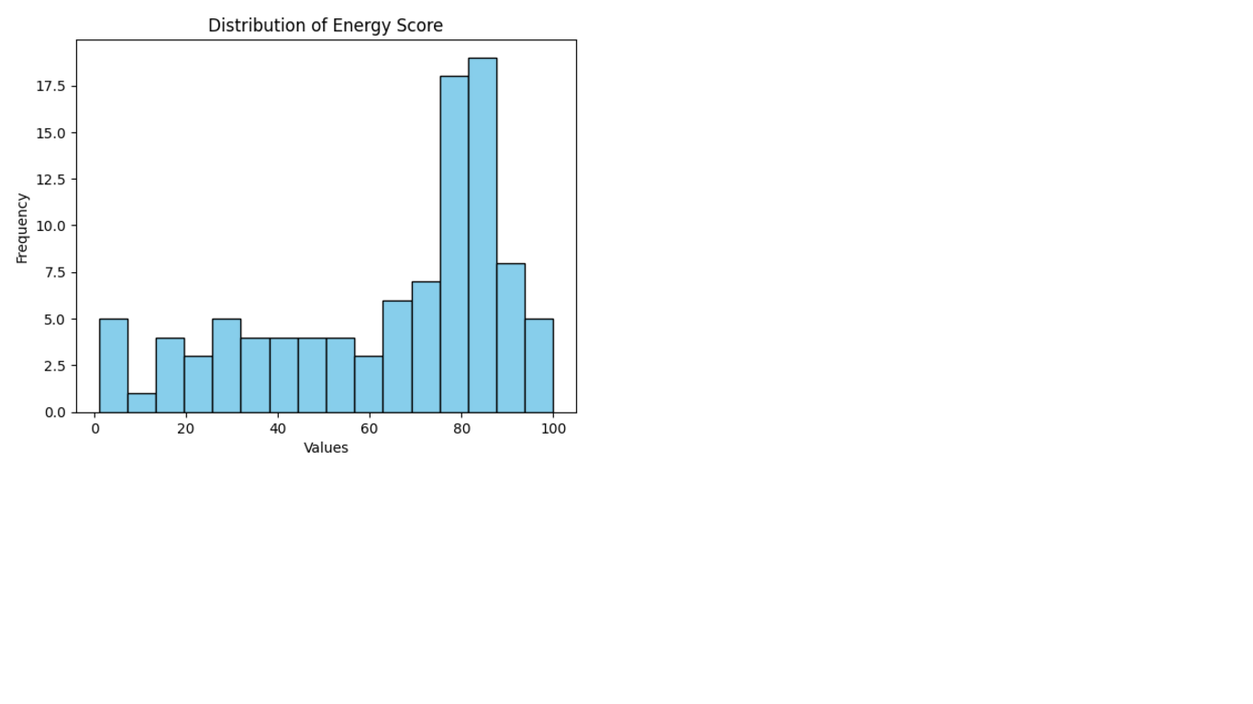
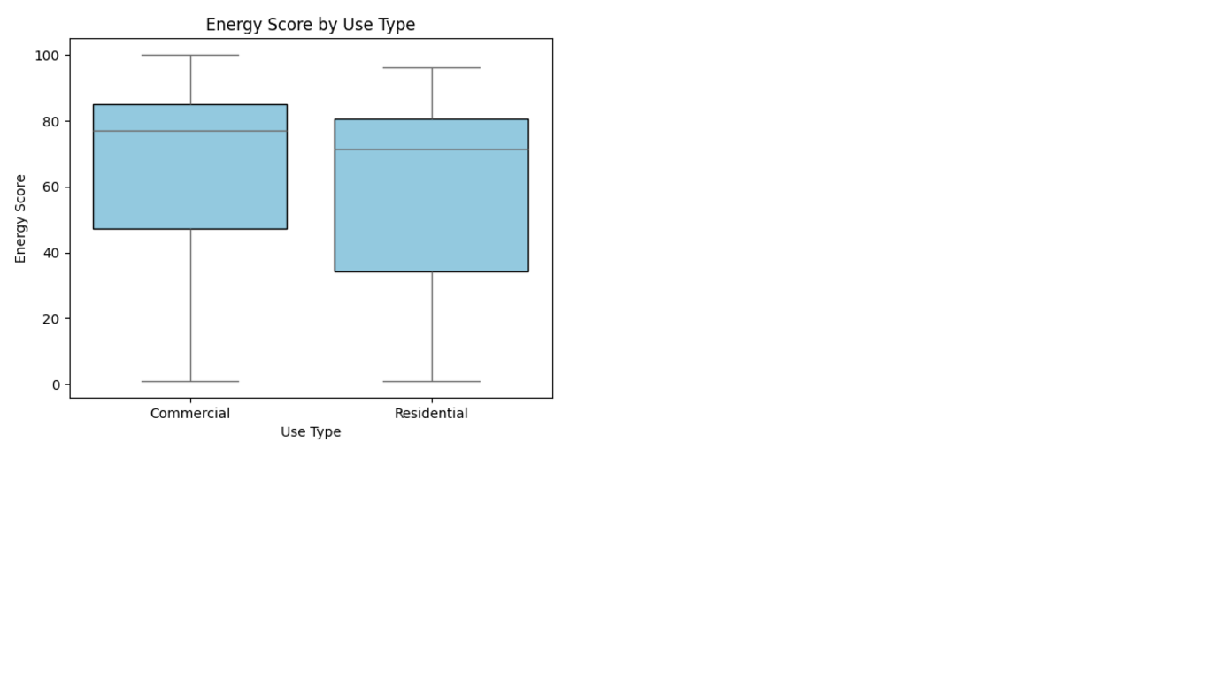
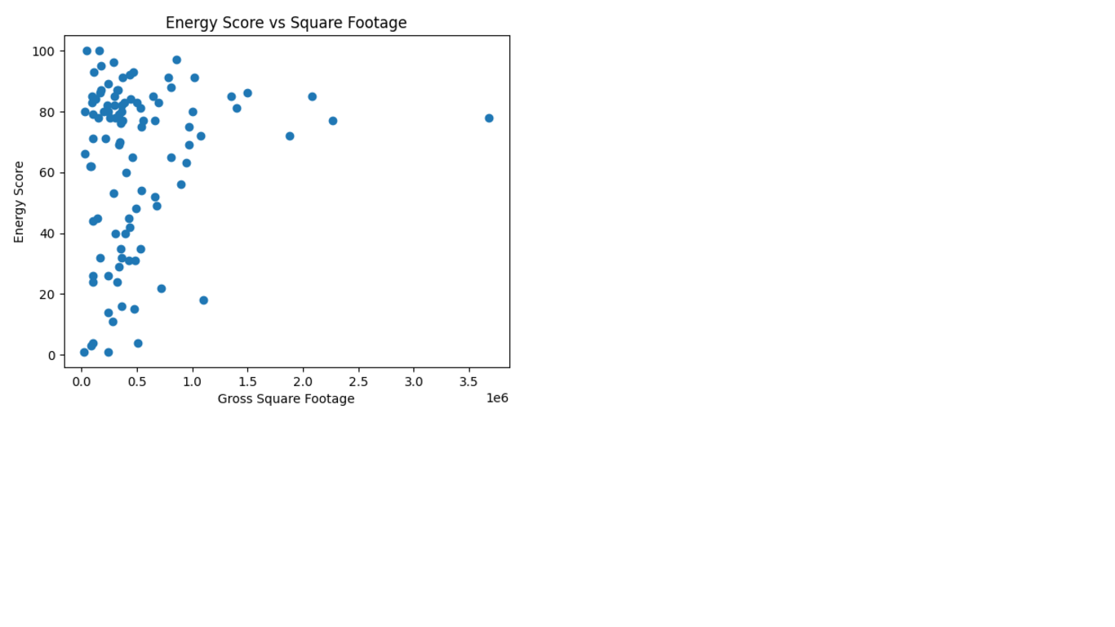
VISUALIZING VARIABLES
Normal distribution with left skew
Normal distribution with left skew
Nonlinear results for numerical variables

Slide 6
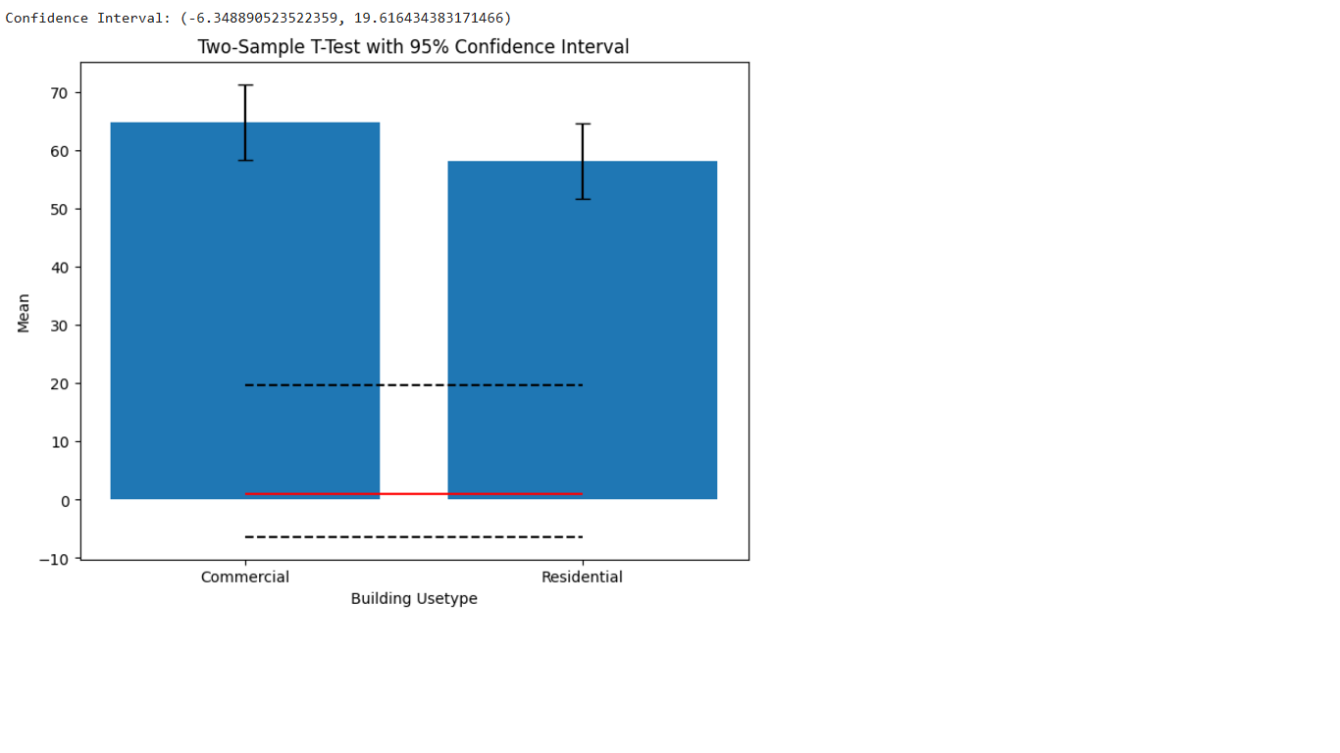
TWO SAMPLE T-TEST
RESULTS:
P-value: 0.2714186030696413
T-statistic: 1.106036230489975
Confidence Interval: (-6.2016471246112985, 20.51559404725387)
Null hypothesis: Difference of the means of the energy scores of residential and commercial buildings is equal to zero, cannot be rejected.

Slide 7
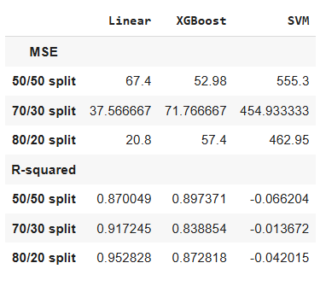
PREDICTING ENERGY SCORES
Best Model: Linear regression model with an 80/20 split
Results: MSE of 20.8 and an R-squared of 0.952828

Slide 8
CONCLUSION
Study indicates no difference between energy scores of residential and commercial buildings
Residential buildings only represented 20% of data
Social media can be leveraged to assist building occupancy data

Slide 9
LIST OF REFERENCES
1. Dougherty, T., Jain, R. (2023). Invisible walls: Exploration of microclimate effects on building energy consumption in New York City. Sustainable Cities and Society, 90. https://doi.org/10.1016/j.scs.2022.104364
2. Hossain J, Kadir AFA, Hanafi AN, Shareef H, Khatib T, Baharin KA, Sulaima MF. (2023). A review on optimal energy management in commercial buildings. Energies.16(4):1609. https://doi.org/10.3390/en16041609
3. Olu-Ajayi, R., Alaka, H., Owolabi, H., Akanbi, L., & Ganiyu, S. (2023). Data-driven tools for building energy consumption prediction: a review. Energies,16(6):2574. https://doi.org/10.3390/en16062574

